Slide 1
Contract Monthly Claim System
Streamlining claim creation, review, and invoice creation

Slide 2
The Challenge Solved: Value at a Glance
Simplified Claim Submission: Effortless, accurate claims for Lecturers.
Automated Review & Approval: Expedites the process with configurable business logic.
Robust Security: Protects sensitive financial and personal data.
Clear Role Separation: Defines responsibilities for Admin, HR, Lecturers, and Reviewers.
Instant Invoicing: Generates invoices for approved claims, accelerating payment cycles.
The system transforms a manual, error-prone process into a secure, highly efficient, and transparent digital workflow, saving time and improving financial accuracy.

Slide 3

Security & Access Control
Cookie-Based Authentication: Custom, secure session management.
Advanced Password Security: Passwords are stored securely using hashing and salting (avoiding plain-text storage).
Role-Based Authorisation: Access to functionality is strictly controlled by assigned user roles (Admin, HR, Lecturer, Reviewer).

Slide 4
Clear Responsibilities: Three Key Roles
Admin | HR | Lecturer | Reviewer
Full management access | Manage Users/Roles | Create & Submit Claims | Review Pending Claims
Set user roles | Manage Lecturer/Module Rates | Track Claim Status | Configure Auto Review Rules
Create/Delete Roles | Invoice Generation | Download Supporting Docs | Run Auto Review

Slide 5
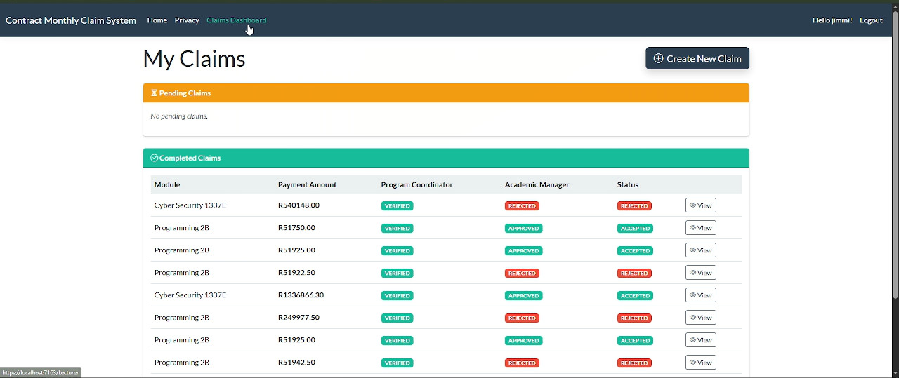
Lecturer Dashboard: Fast & Accurate Claims
Intuitive Claim Creation: Simple form to select module and input hours worked.
Real-time Calculation: Hourly rate (assigned by HR) and estimated total payment update instantly.
Secure Document Upload: Attach supporting files (up to 10MB) for validation.
Encrypted Storage: All uploaded documents are encrypted at rest and decrypted securely upon download.
Claims Dashboard: Overview of all personal claims, sorted by review status.
Minimizes input errors and provides immediate payment estimates, speeding up the lecturer's administrative task.

Slide 6
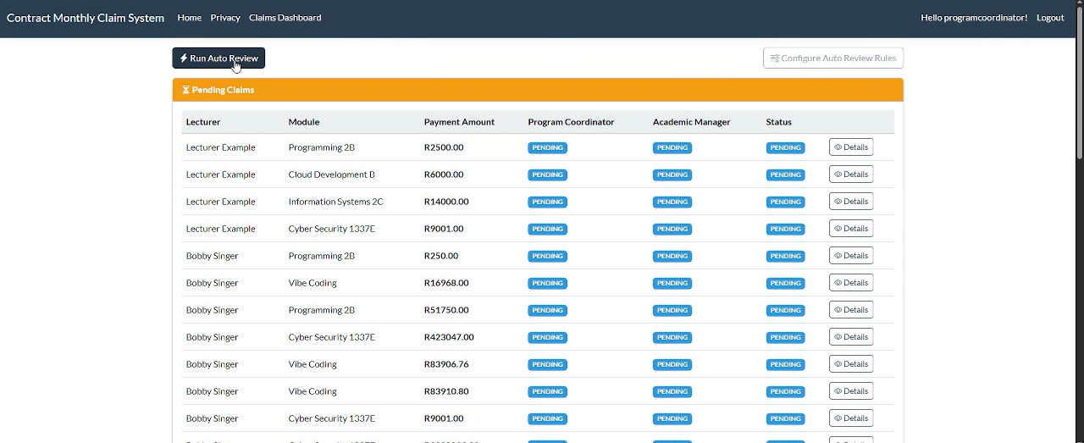
Reviewer Workflow: Dual-Layer Approval
Reviewer Dashboards: Dedicated views for Program Coordinators and Academic Managers.
Two-Stage Review Process: Claims move from PENDING to PENDING_CONFIRM after one review, and finally to ACCEPTED or REJECTED only after both reviewer types approve or if either rejects.
Decision Options: Program Coordinators (Verify), Academic Managers (Approve), or (Reject).
Real-time Visibility: Review decisions are immediately visible to the lecturer and other reviewers.
Enforces a necessary, two-step control mechanism for claim validation, ensuring compliance and accuracy.

Slide 7
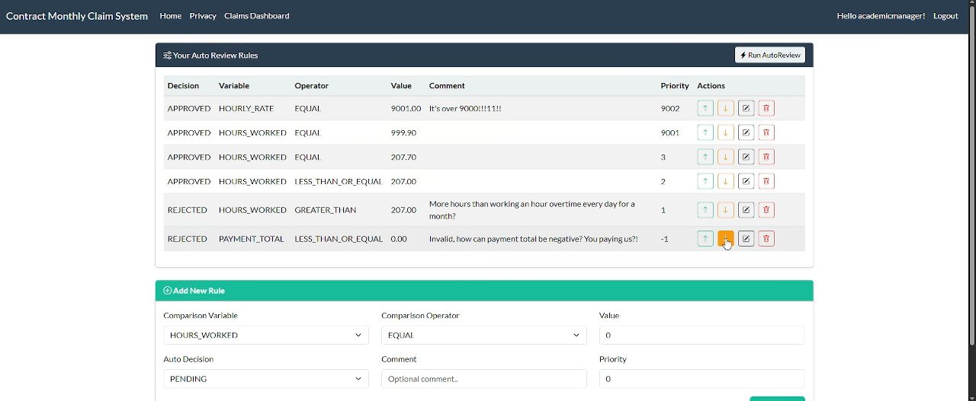
Driving Efficiency with Auto Review Rules
Configurable Rules: Reviewers can define rules based on claim variables (HOURS_WORKED, HOURLY_RATE, PAYMENT_TOTAL).
Automatic Decisions: Rules auto-apply decisions (VERIFIED, APPROVED, or REJECTED) if the defined condition is met.
Priority Management: Higher priority rules can override decisions made by lower priority rules during a single run.
HR Automation: HR can run the Auto Review function on behalf of all reviewers, ensuring immediate processing of applicable claims without manual intervention.
Dramatically reduces manual review workload, allowing reviewers to focus only on complex or high-value claims, while ensuring immediate processing for routine claims.

Slide 8
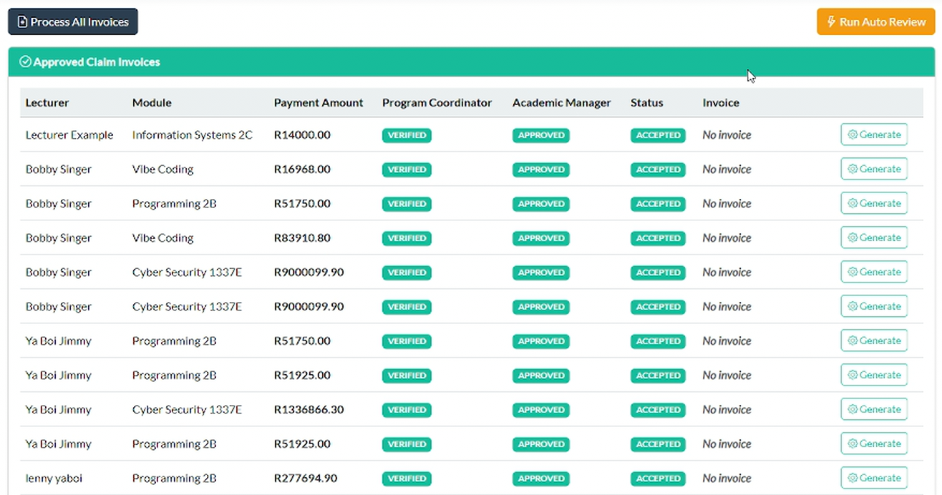
HR Module: Seamless Financial Control
Comprehensive Management: HR manages users, roles, modules, and sets lecturer hourly rates.
Bulk Invoice Processing: Button to "Process All Invoices" generates PDF invoices for all approved claims not yet invoiced.
Secure Invoice Download: Generated PDF invoices are encrypted for storage.
Operational Insight: Dashboards provide an overview of approved claims and invoice status.
Centralizes administrative and financial control, providing a secure, auditable, and highly efficient mechanism for payroll and invoicing.

Slide 9
The Contract Monthly Claim System Advantage
Secure: Hashed passwords and encrypted file storage.
Automated: Auto Review for expedited claim processing.
Transparent: Clear, role-based dashboards and status tracking.
Efficient: Real-time calculations and bulk invoice generation.
"Experience the next generation of contract claim management."

